Slide 1

CSE101-lec#12
Recursive function(or Recursion)
Mathematical functions in C(<math.h> header file)

Slide 2
Outline
Recursion
Examples of recursion
Finding factorial of a number
Finding sum of all numbers from 1 to n
Printing n terms of Fibonacci series using recursion
Recursion Vs Iteration
Mathematical functions in C

Slide 3
Recursion
It is a process in which function calls itself again and again and the function which is called is known as recursive function
Recursion is supported with two cases: base case and recursive case
Base case is one which helps to stop the recursion once the required operation is done
Recursive case is one which keeps on repeating and function will keep on calling itself

Slide 4
Example
int fact(int n)
{
if (n < = 1) // base case( Here the recursion will stop)
return 1;
else
return n*fact(n-1); //recursive case where fact() is calling itself
}

Slide 5
Recursion example (factorial)

Slide 6
Program example 1-Write a program to find the factorial of a number using recursion(or recursive function)
#include <stdio.h>
long long int factorial(int);
int main()
{
int n;
printf("Enter a positive integer: ");
scanf("%d", &n);
printf("Factorial of %d = %lld", n, factorial(n));
return 0;
}
long long int factorial(int n)
{
if (n <=1)
return 1;
else
return n*factorial(n-1);
}

Slide 7
Program example 2-Write a program to find the sum of all numbers from 1 to n using recursion(or recursive function)
#include <stdio.h>
int addNumbers(int n);
int main()
{
int num;
printf("Enter a positive integer: ");
scanf("%d", &num);
printf("Sum = %d",addNumbers(num));
return 0;
}
int addNumbers(int n)
{
if(n == 0)
return n;
else
return n + addNumbers(n-1);
}

Slide 8
Recursion example-3 (Fibonacci series)
What is Fibonacci series: …??
0, 1, 1, 2, 3, 5, 8...
Each number is the sum of the previous two
Can be solved recursively:
fib( n ) = fib( n - 1 ) + fib( n – 2 )
Code for the fibonacci function
long fibonacci( long n )
{
if (n == 0 || n == 1) // base case
return n;
else
return fibonacci( n - 1)+fibonacci( n – 2 );
}

Slide 9
Recursion example (fibonacci)
Set of recursive calls to fibonacci() function
f( 3 )
return
f( 2 )
+
f( 1 )
return
f( 1 )
+
f( 0 )
return 1
return 1
return 0

Slide 10
Program example 3-WAP to display n terms of Fibonacci series using recursion(or recursive function)
#include<stdio.h>
int Fibonacci(int);
int main()
{
int n, i;
printf("\n Enter number of terms you want to print:");
scanf("%d",&n);
printf("Fibonacci series\n");
for(i=0;i<n;i++)
{
printf("%d\n", Fibonacci(i));
}
return 0;
}
int Fibonacci(int n)
{
if ( n == 0 )
return 0;
else if ( n == 1 )
return 1;
else
return ( Fibonacci(n-1) + Fibonacci(n-2) );
}

Slide 11
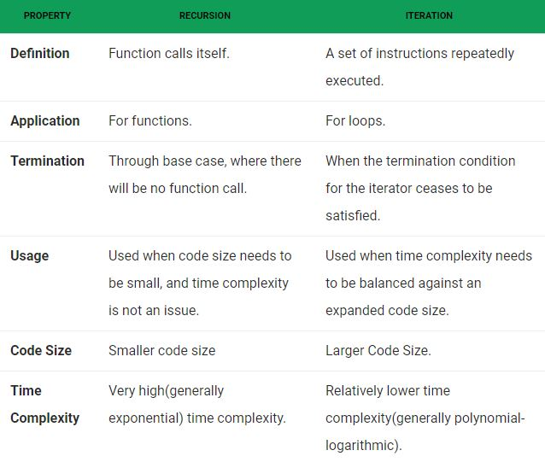
Recursion vs. Iteration

Slide 12
Rules for recursive function
In recursion, it is essential to call a function itself
Only the user defined function can be involved in the recursion. Library function cannot be involved in recursion because their source code cannot be viewed
A recursive function can be invoked by itself or by other function.
To stop recursive function, it is necessary to have a proper base case, otherwise infinite recursion can happen
main() function can be invoked recursively.

Slide 13
Math Library Functions(or Mathematical functions in C)
Math library functions
perform common mathematical calculations
#include <math.h>
Format for calling maths functions
functionName( argument );
If multiple arguments, use comma-separated list
Example:
printf( "%.2f", sqrt( 900.0 ) );
Calls function sqrt, which returns the square root of its argument
All math functions return data type double
Arguments may be constants, variables, or expressions

Slide 14
Math Library Functions
Notes:
Explain functions(SQRT, FABS,CEIL, FLOOR,POW) in detail

Slide 15
Math Library Functions: pow()
The power function, pow(x,y), calculates x^{y}; that is, the value of
pow(x,y) = x^{y}.
pow(2,3)= 2³ = 8.0 and pow(2.5,3) = 15.625.
The function pow is of the type double or that the function pow returns a value of the type double.
x and y are called the parameters (or arguments) of the function pow.
Function pow has two parameters.

Slide 16
sqrt()
The square root function, sqrt(x),
calculates the non-negative square root of x for x >= 0.0
sqrt(2.25) is 1.5
sqrt(25) is 5.0
The function sqrt is of the type double and has only one parameter.

Slide 17
fabs()
fabs calculates the absolute value of a float argument.
fabs(2.25) is 2.25
fabs(-25.0) is 25.0
The function fabs is of the type double and has only one parameter.

Slide 18
floor()
The floor function, floor, calculates the largest whole number that is not greater than x.
floor(48.79) is 48.0
floor(48.03) is 48.0
floor(47.79) is 47.0
The function floor is of the type double and has only one parameter.

Slide 19
ceil()
The ceil function, ceil, calculates the smallest whole number that is not less than x.
ceil(48.79) is 49
ceil(48.03) is 49
ceil(47.79) is 48
The function ceil is of the type double and has only one parameter.

Slide 20
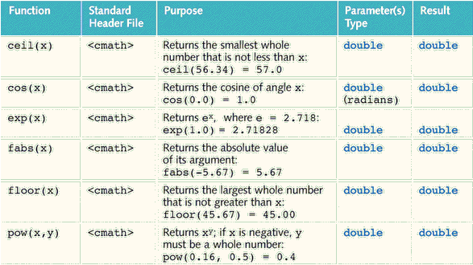

Slide 21
Program example
#include<stdio.h>
#include<math.h>
int main()
{
double x=9.0,y=8.0,z=7.0;
printf("\nLog value is:%lf",log(x));
printf("\nLog value with base 10 is:%lf",log10(x));
printf("\nExponential value is:%lf",exp(x));
printf("\n Ceil value is:%lf",ceil(8.94));
printf("\n Floor value is:%lf",floor(2.34));
printf("\n Power:%lf",pow(3.0,2.0));
printf("\n Floating absolute is:%lf",fabs(-2.9));
printf("\n Square root value is:%lf",sqrt(9));
printf("\n Sin:%f,cos:%f,tan:%lf",sin(x),cos(y),tan(z));
printf("\n fMod:%f",fmod(2.0,1.5));
return 0;
}

Slide 22
Q1
What is the output of the following code?
void my_recursive_function(int n)
{
if(n == 0)
return;
printf("%d ",n);
my_recursive_function(n-1);
}
int main()
{
my_recursive_function(5);
return 0;
}
5
1
5 4 3 2 1 0
5 4 3 2 1
Notes:
D

Slide 23
Q2
Predict output of following program
#include <stdio.h>
int fun(int n)
{
if (n == 4)
return n;
else return 2*fun(n+1);
}
int main()
{
printf("%d ", fun(2));
return 0;
}
4
8
16
10
Notes:
C

Slide 24
Q3
Consider the following recursive function fun(x, y). What is the value of fun(4, 3)
int fun(int x, int y)
{
if (x == 0)
return y;
return fun(x - 1, x + y);
}
13
12
9
10
Notes:
A

Slide 25
Q4
What does the following function print for n = 25?
void fun(int n)
{
if (n == 0)
return;
printf("%d", n%2);
fun(n/2);
}
11001
10011
11111
00000
Notes:
B

